Slide 1
Transfer Council

Slide 2
Mission
The Transfer Council was established for the purpose of supporting and advocating for the approximately 500 students who transfer to Georgetown University.
We work to ensure that transfers feel welcome and are given the resources not only to succeed, but also to thrive.
Our purpose includes advocating to improve the admissions process, orientation process, housing process and placement, academic life, and career preparation.
Additionally, we will engage in programming to build an inclusive Transfer community.

Slide 3
Current Uses of Funding
Fall 2018 - (our first semester as a formal organization)
Welcome Back Event (with GWOW)
Transfer Council Meet and Greet
Homecoming Mixer (with ~10 transfer alumni)
Midterm Study Break (cider & coloring with LLC)
Pumpkin Carving
Finals Study Break (baking with GIVES)
Two workshops with the Career Center
Average of 25-30 transfer students at each event

Slide 4
Current Uses of Funding (con’t)
Spring 2019
Spring NSO evening activities (GLOW & M St. tour, Baked & Wired social, board game night) (75 students)
Transfer Formal (55 students)
Georgetown Basketball game (25 students)
Service Event (25 students)
Pinstripes Bowling & Dinner (forecasting 40 students)

Slide 5
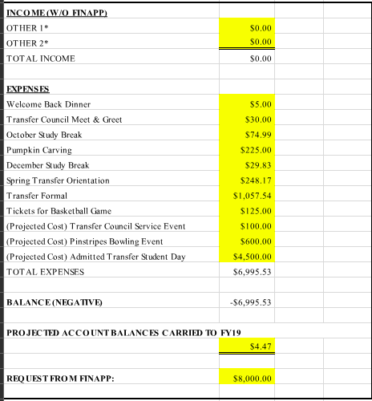

Slide 6
Reasons for Increase in Future Funding
More direct involvement in Fall NSO & Spring NSO
Currently $225
Want to do more structured programming, like bowling or a movie night ($600)
Support transfer volunteers ($100)

Slide 7
Reasons for Increase in Future Funding (cont.)
More event programming
Monthly Dinners
Study Hours (with Corp coffee)
Larger Formal
$100

Slide 8
Reasons for Increase in Future Funding (cont.)
More robust ATSD
Similar to a transfer version of GAAP weekend
$300 for Class Year T-shirts, more food, and support for volunteers

Slide 9
Questions?

